Slide 1

Easy Connect Online
Learning is FUN
Learn To Create New

Slide 2
Motto:
The main motto of the EASY CONNECT ONLINE(ECO) is to reach the knowledge to maximum people and learn everything having FUN.
Students Guide to evolve and grow their minds brilliantly without any stress and pressure.
As a sample ECO team has just developed based on a BTech domain only to understand our idea in a brief way.
To boost up creative skills and innovative ideas.
ECO main theme is to change the present educational system applications and scenario for a better tomorrow.

Slide 3
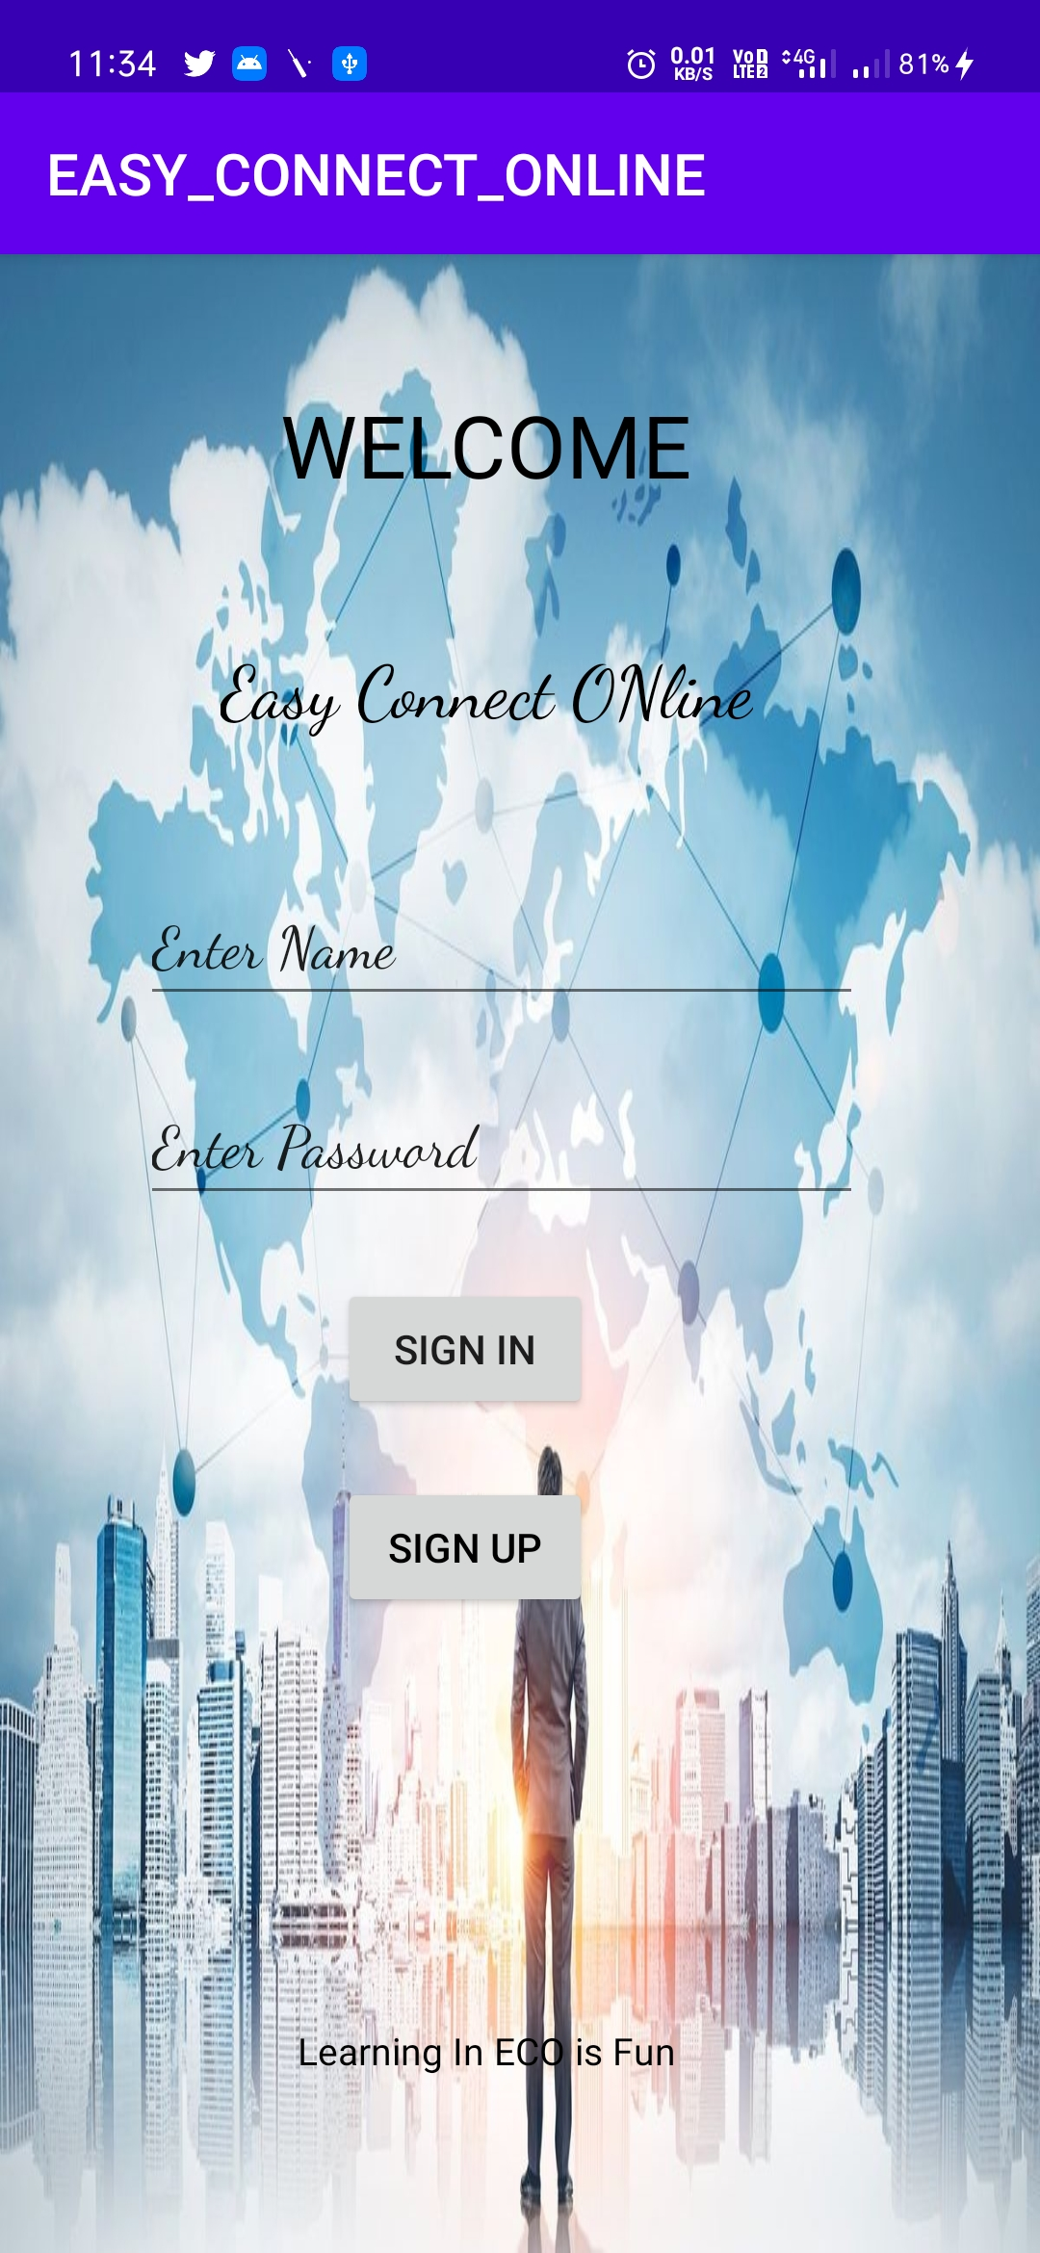
ECO WELCOME PAGE:
It display “ signin” and “signup”

Slide 4
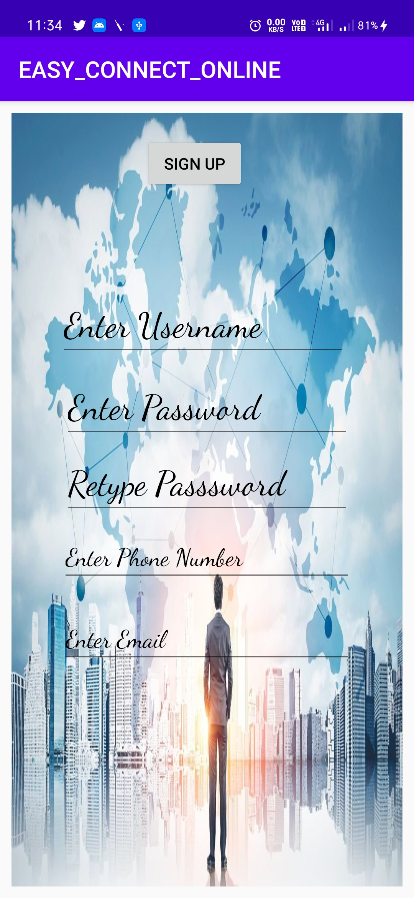
ECO SIGN UP PAGE :
It enable user to enter their details
For registration in ECO profile.

Slide 5
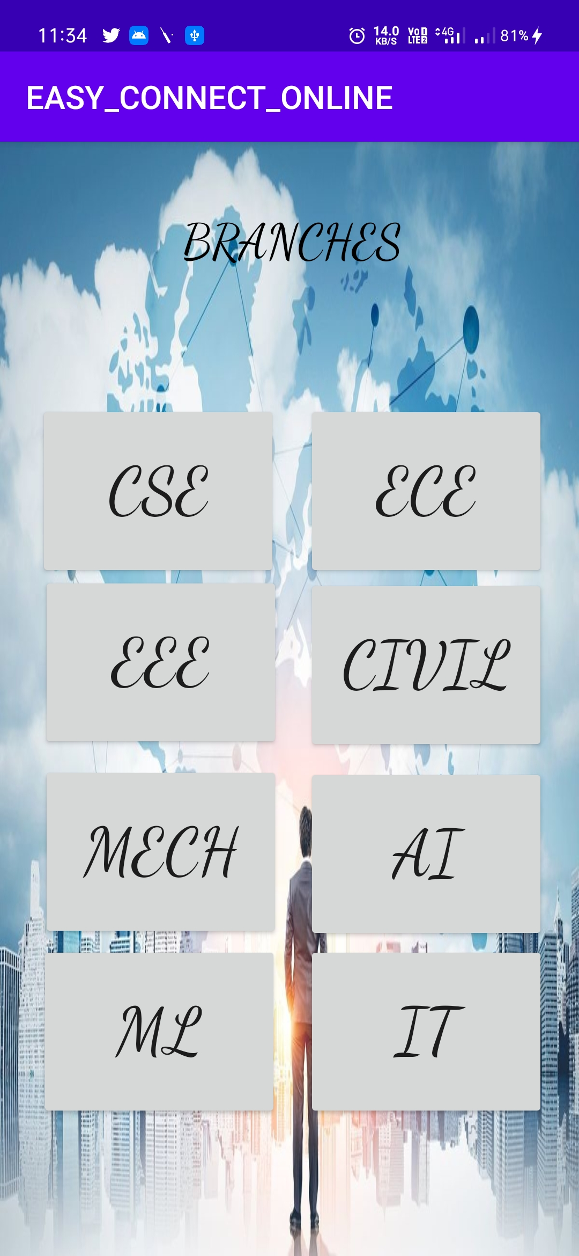
BRANCHES PAGE:
After user sign in or sign up in
ECO .
The user can view this page to select any one branch to access the content (since this application currently designed for B.Tech only).

Slide 6
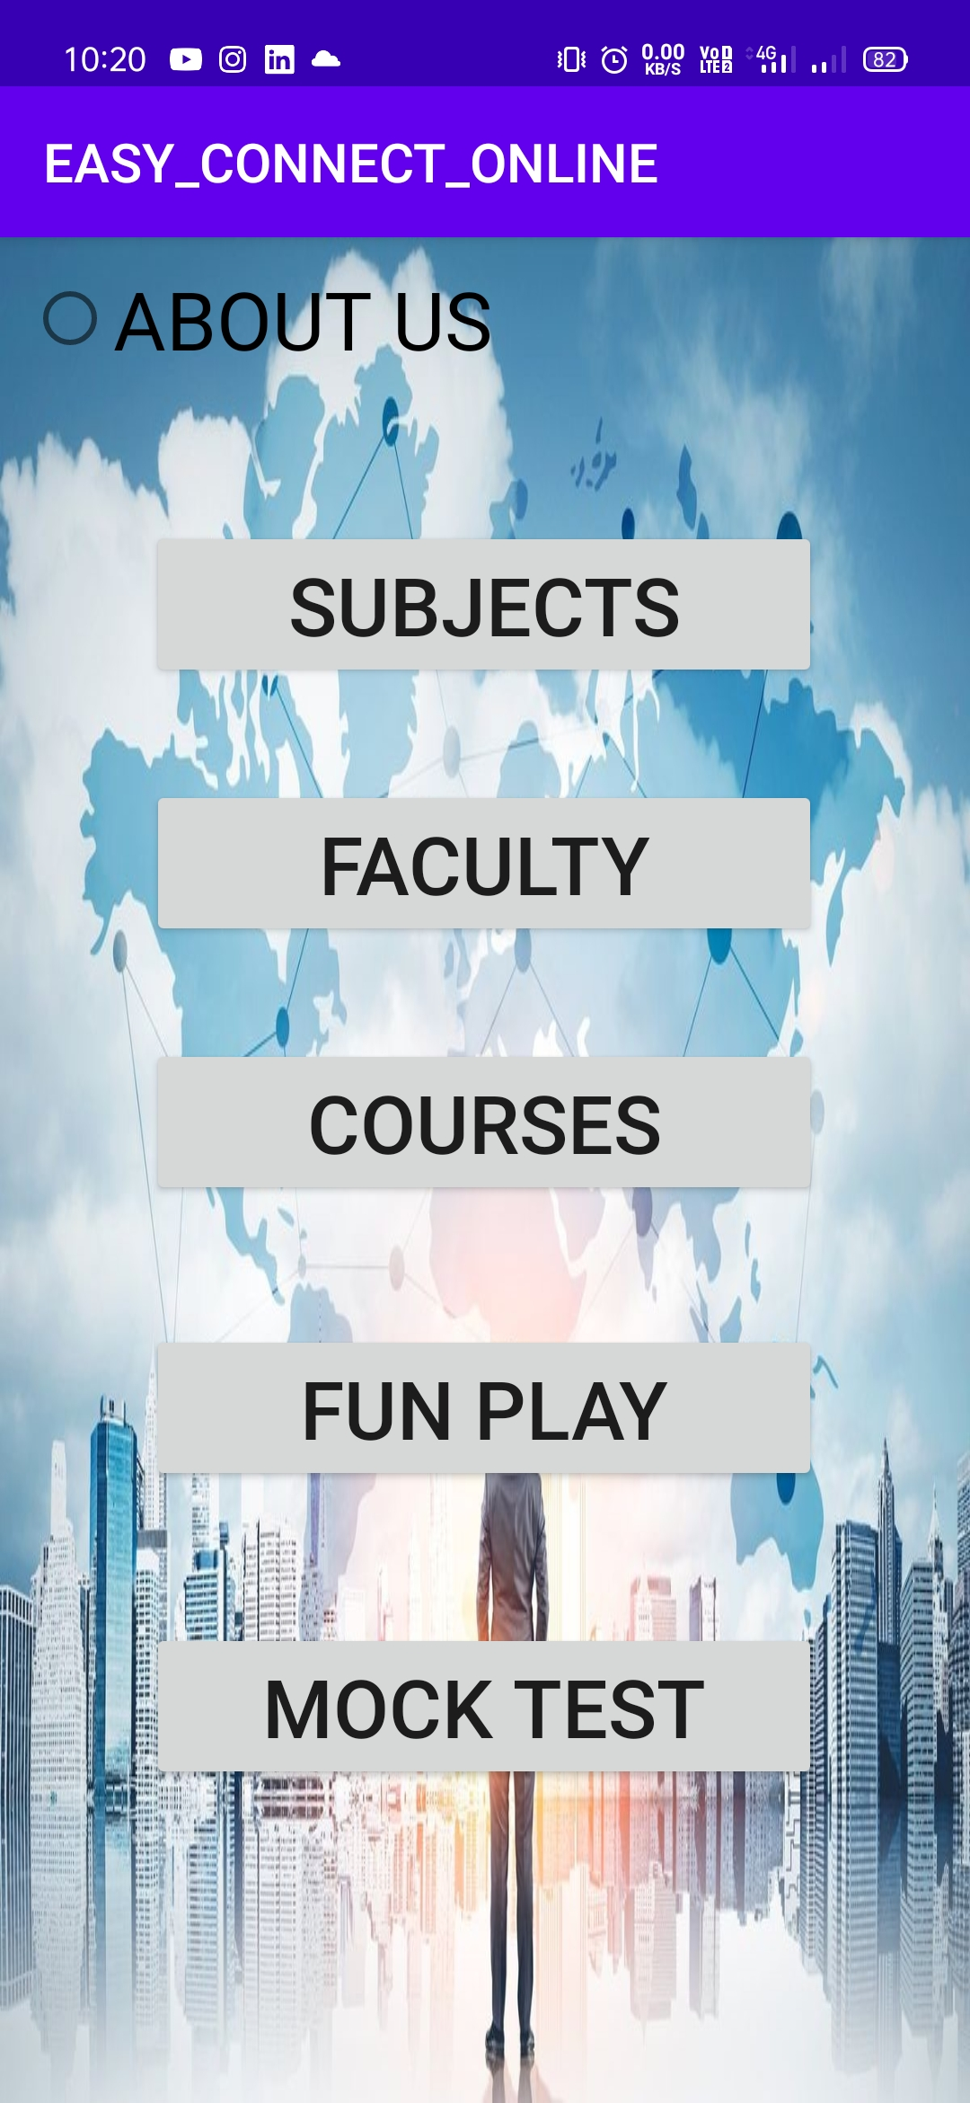
Features in Branch :
After user selecting any one of the branch , user can see this page and select these features and access the information.

Slide 7
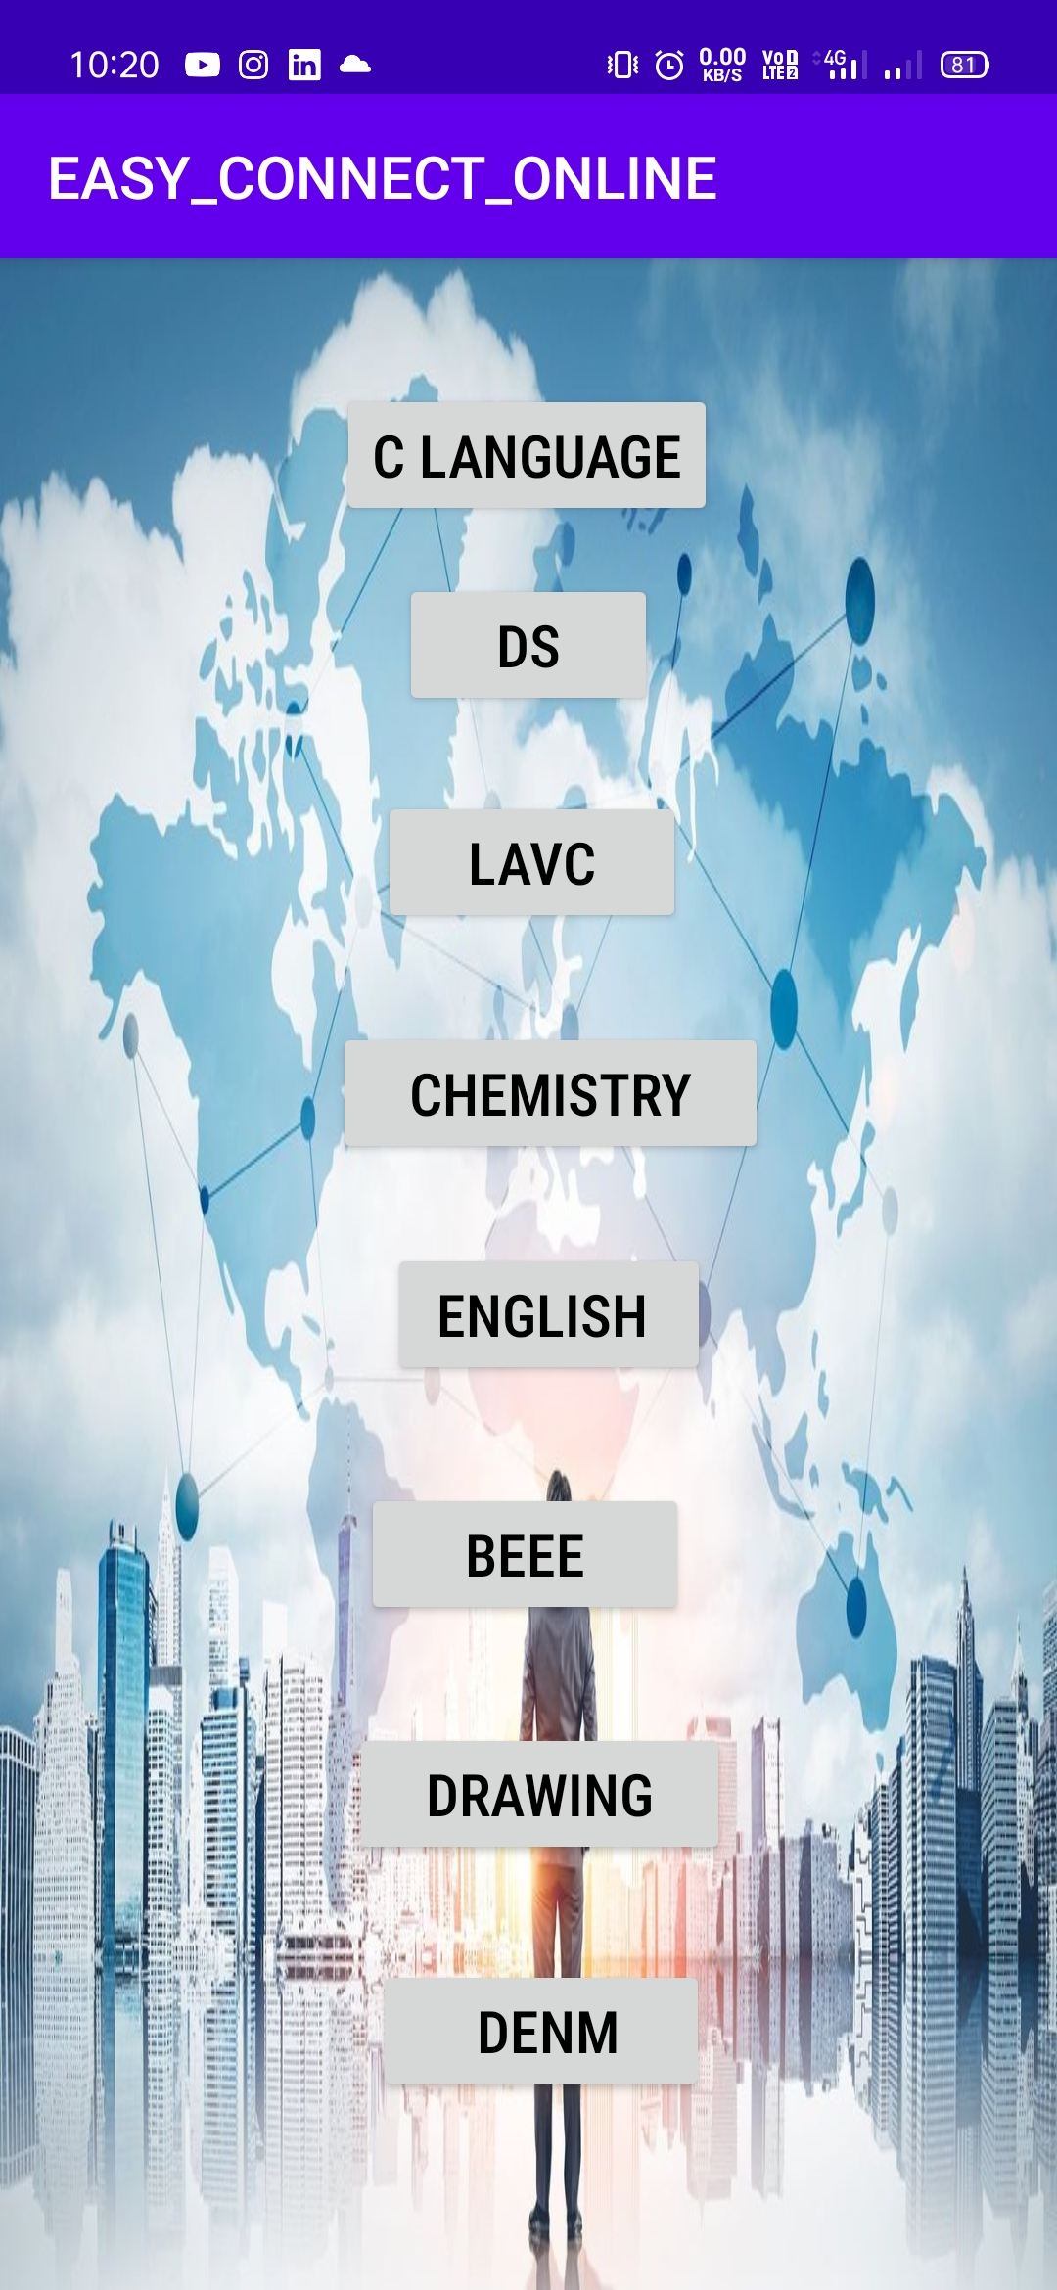
SUBJECT LIST :
In this page user can see the
Different subjects related to each and every individual
Branch .

Slide 8
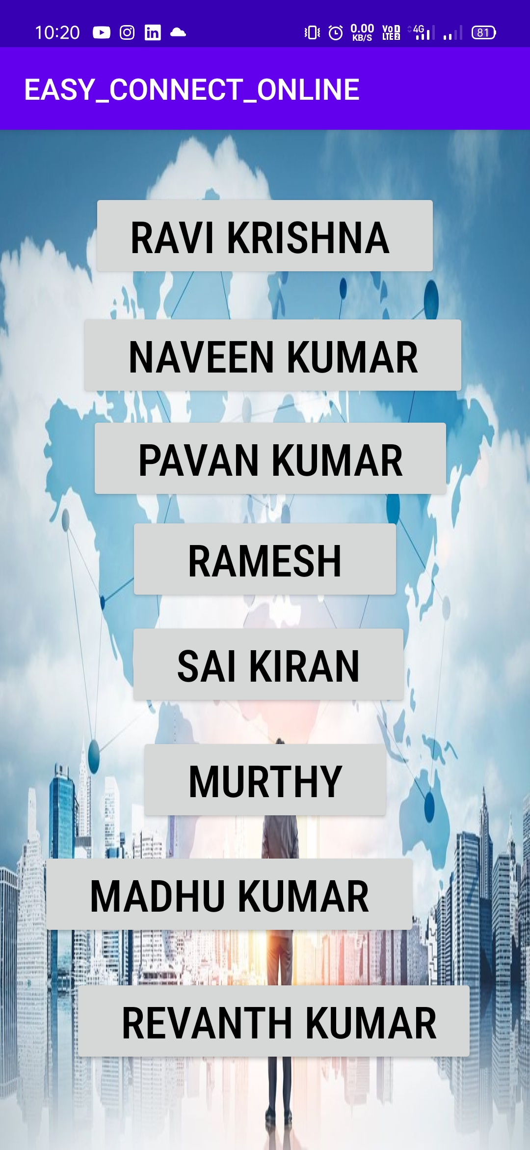
Faculty List :
In this page user can see the
All faculty and also
User can select any one with their own interest.

Slide 9
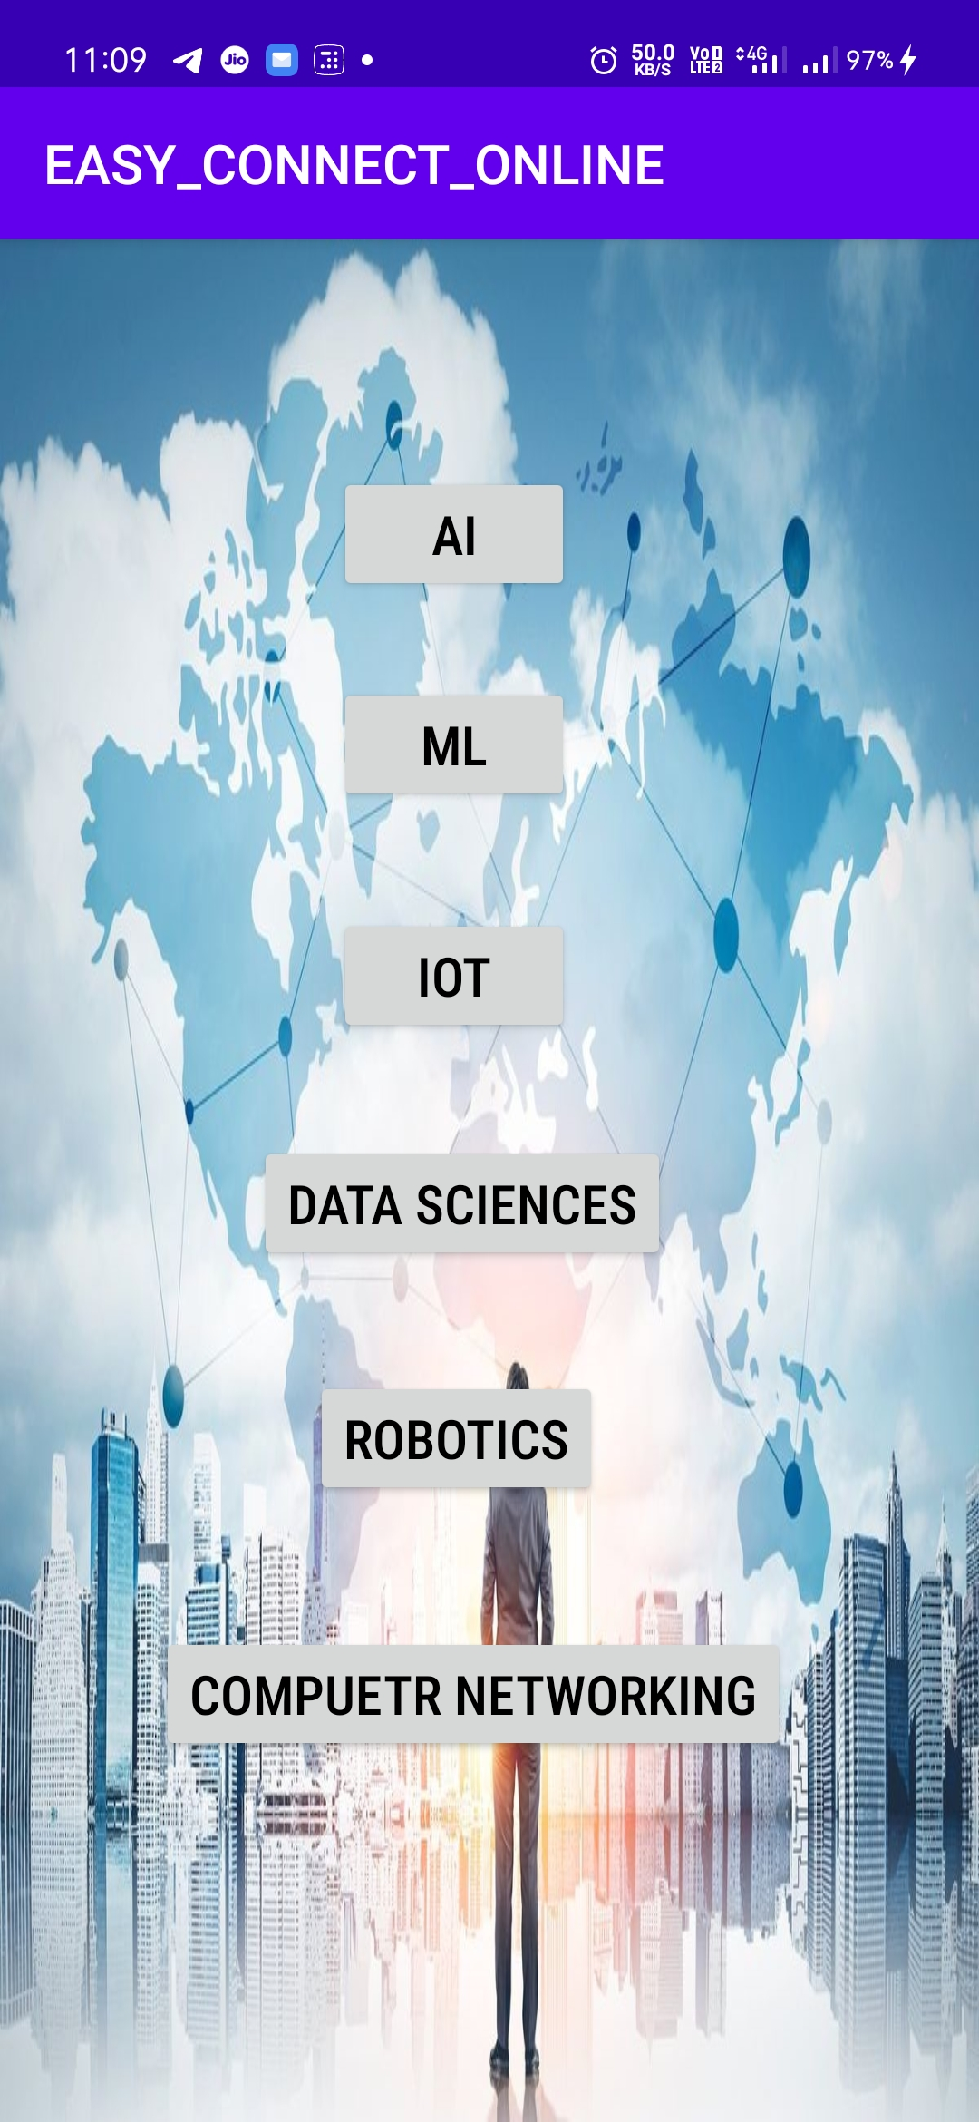
COURCES LIST :
In this user will get the best and free cource along with resources .

Slide 10


ECO special features: FUN PLAY and MOCK TEST which makes users to answer quick and fast to test their knowledge.

Slide 11

About Page :
Our main theme is to every one should connect easily through
ECO and Learn with easy.
E -
C -
O -

Slide 12


